Slide 1
Implementation of VM Tracker-For identification of VM’s marketing collaterals, realtime reporting and sales tracking
Project

Slide 2
What is a VM Tracker?
Real-time Tracking of Current store display status from anywhere.
Real-Time Tracking of current sales rate.
Real-Time Tracking of Inventory List.
Get real-time positioning of each VM.
Watch for reference:
https://youtu.be/DoxMLdrzF-c

Slide 3
Why this topic?
Realtime Tracking of VM
Data accuracy
Improved on-field productivity and decision making.

Slide 4
Objectives
Primary Objective
Real-time-VM Tracking for better visibility
Secondary Objectives
Creation of a Dashboard
Tracking of sales to give a competitive advantage
Identification of marketing collaterals

Slide 5
LITERATURE REVIEW
Merchandising App helps team work more efficiently in the field while building a culture of accountability
AI has the ability to help brands and retailers with predictive forecasting, capacity planning & merchandising
Retail has great growth potential, but the bottleneck here is to differentiate retail business through customer’s perception
Through comprehensive software can streamline sales,marketing and other facets of business like accounts
Retail analytics technologies make visual merchandising more measurable

Slide 6
Proposed Methodology
01
Analysis of the areas of improvement for VM
Survey and discussion with the area managers
02
Identifying the critical improvement areas and marketing collaterals
Areas of tracking possible.
Budgeting and dashboard creation
03
Designed the mobile application for tracking and real time data update
Designing the look of the mobile app
The number of screens needed
The validations required for smooth functioning
04
Defined the process of the app by flowcharts and algorithm
Algorithm and process flow for the complete program to be done.
05
Implemented the changes and generated reports
Tested with visual Merchandisers .
Tested with area manager point of view

Slide 7
Current Update Technique

Slide 8
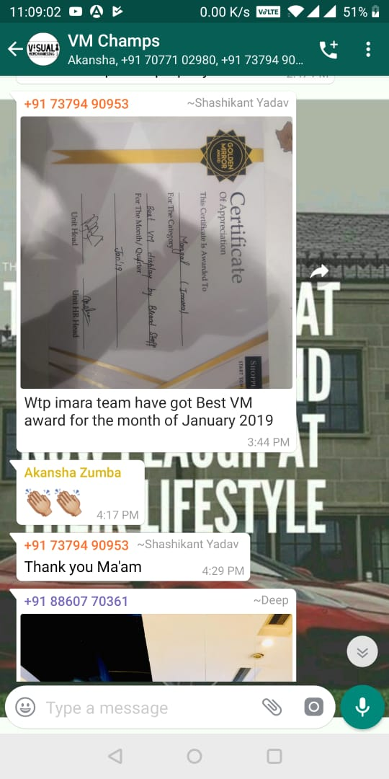
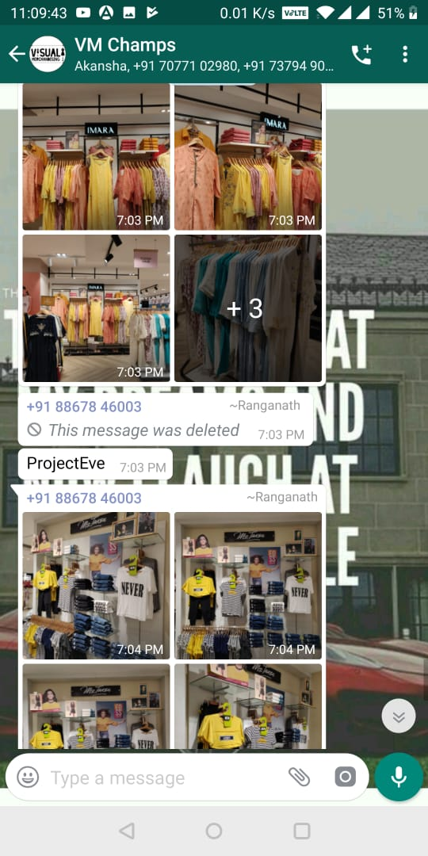
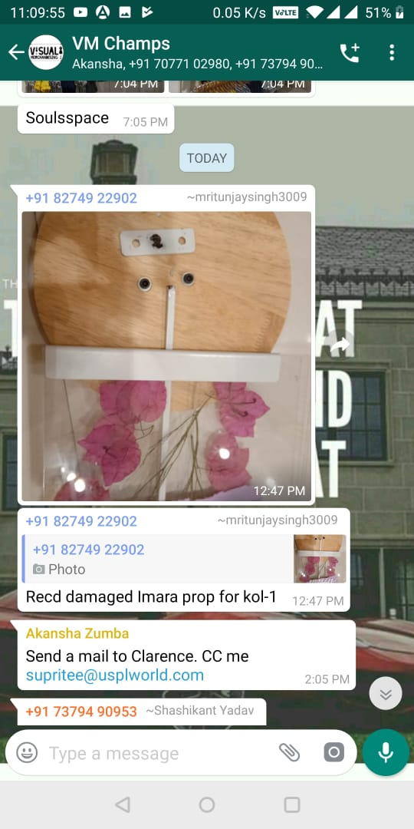

Slide 9
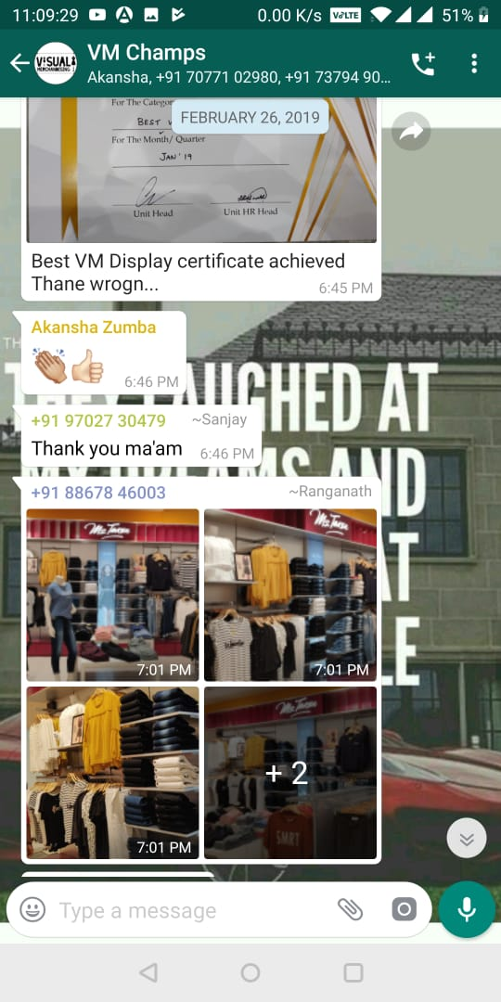
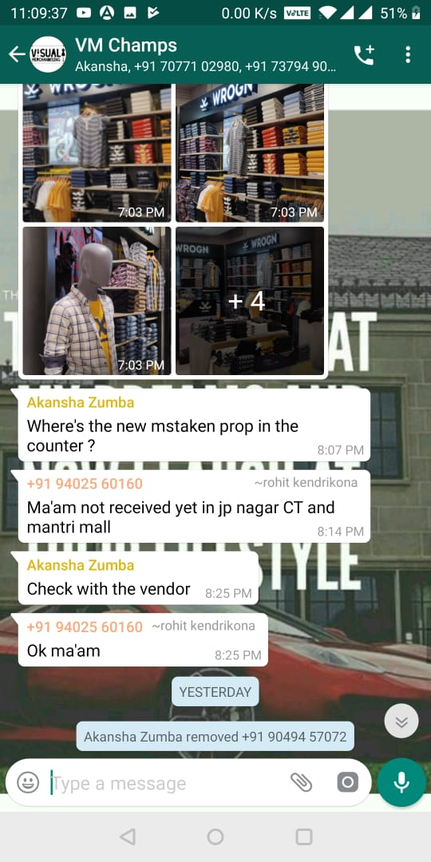
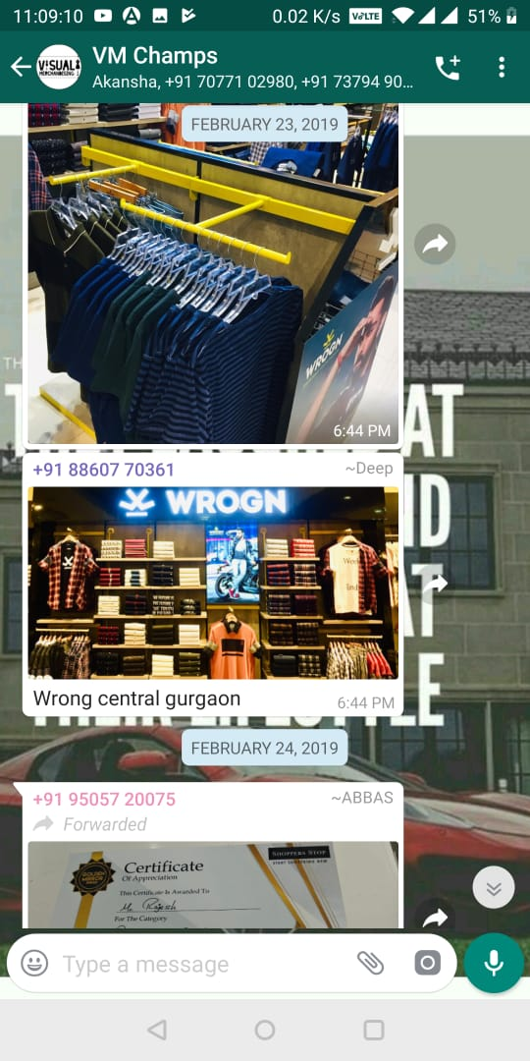

Slide 10
Sources Referred

Slide 11
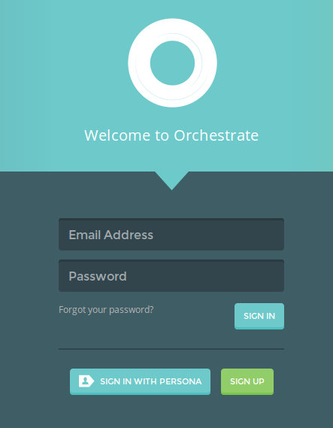
First page - Validation on Access (VM/Manager/Edit)
- ID and Password Check

Slide 12
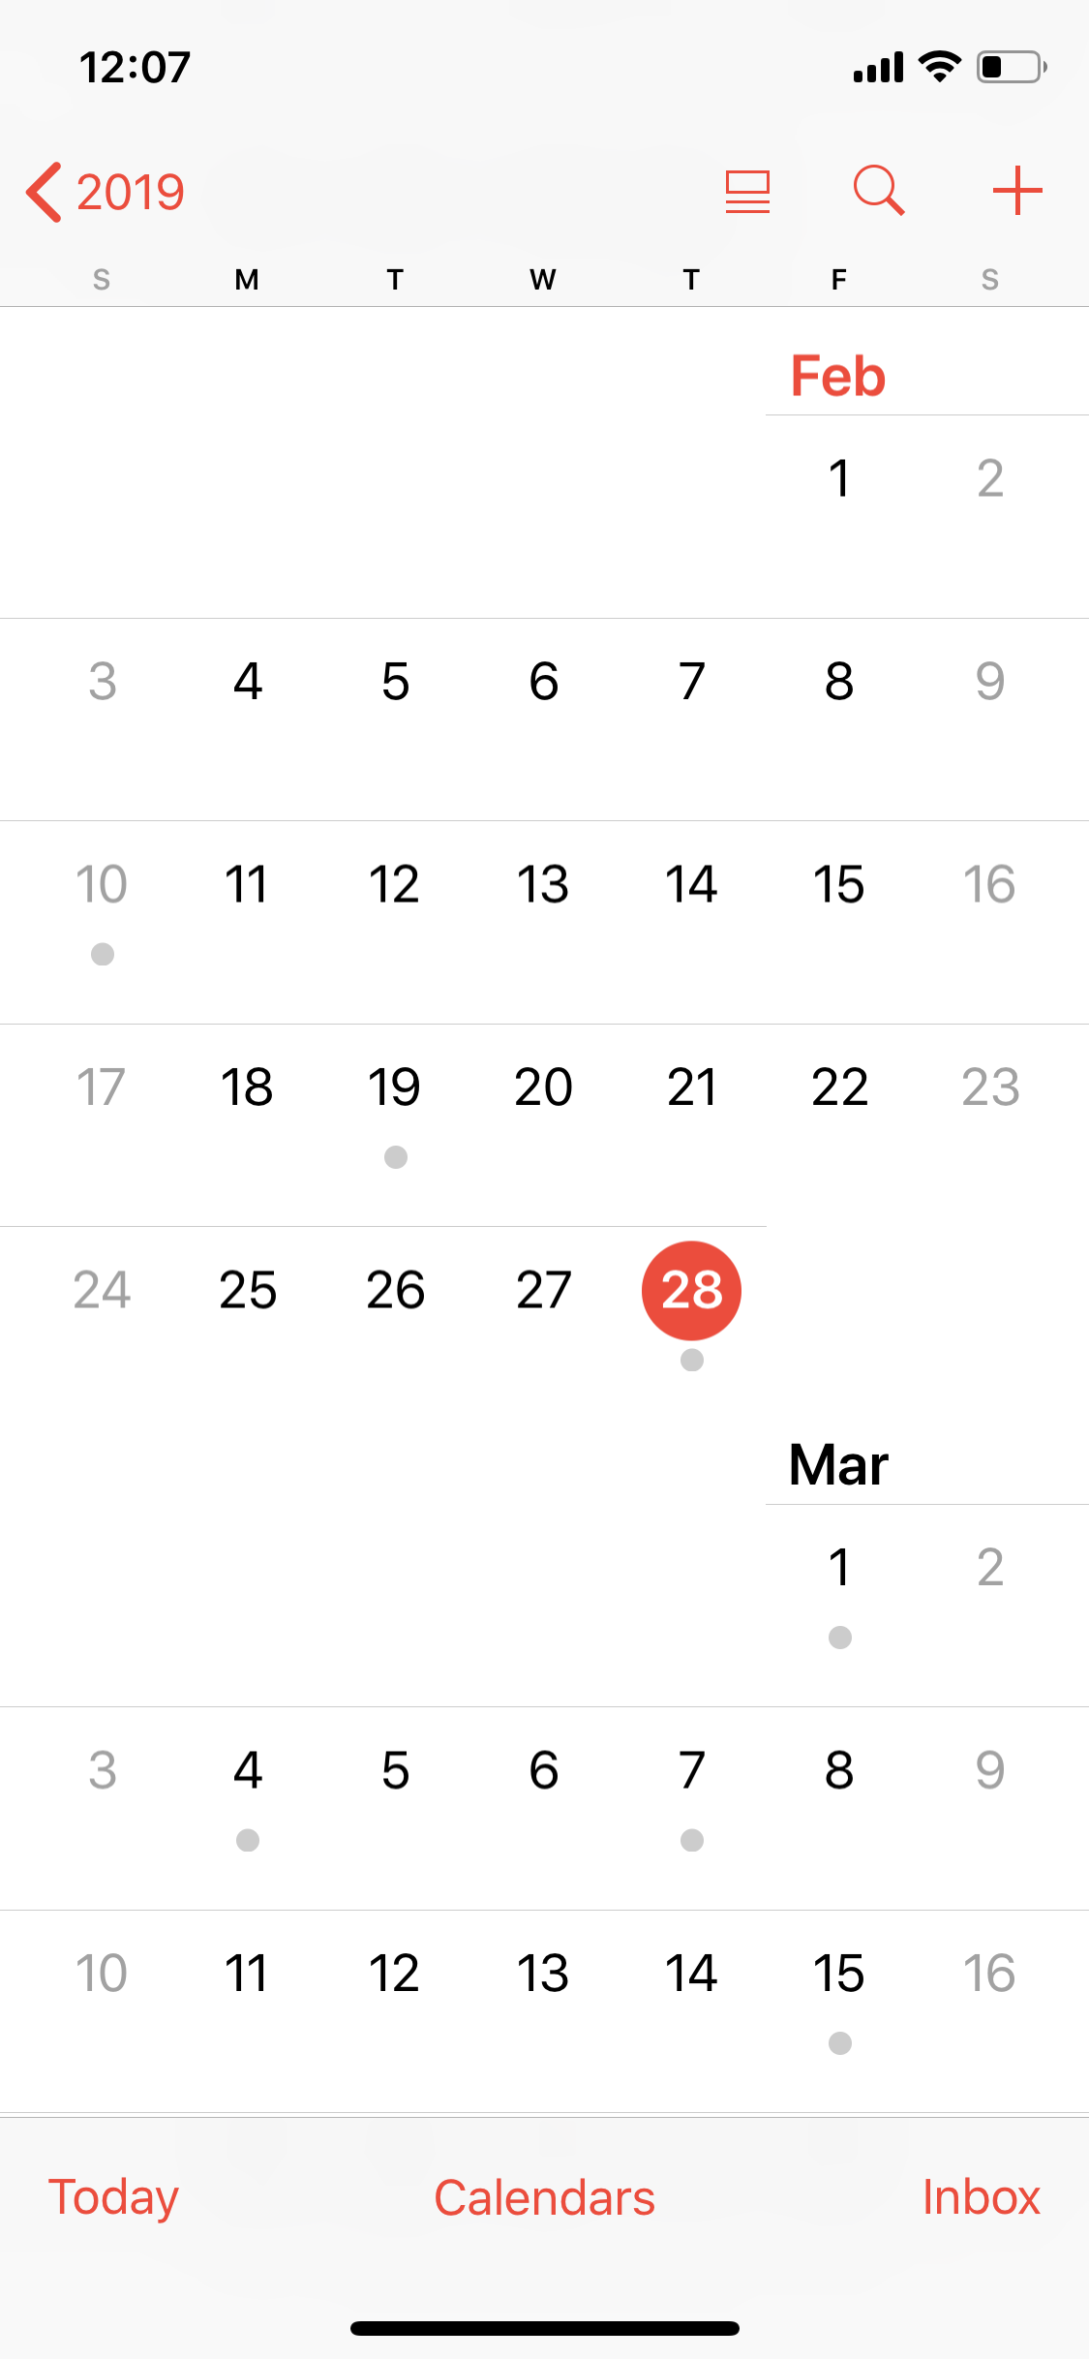
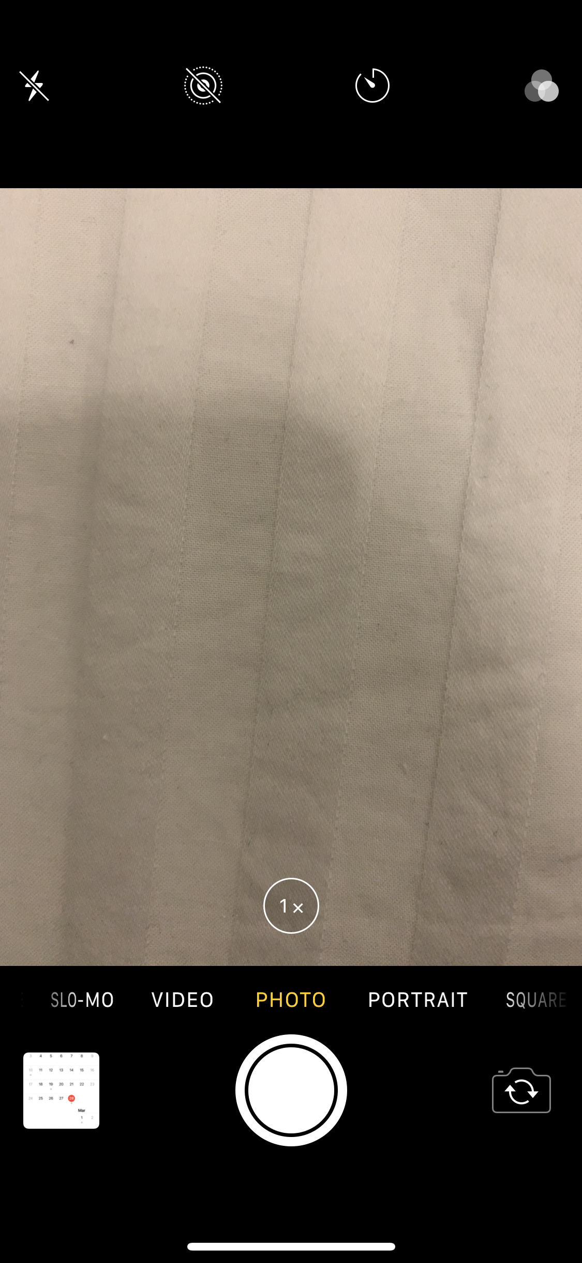
- Calender(Attendance) -Store Image (With Calender)

Slide 13

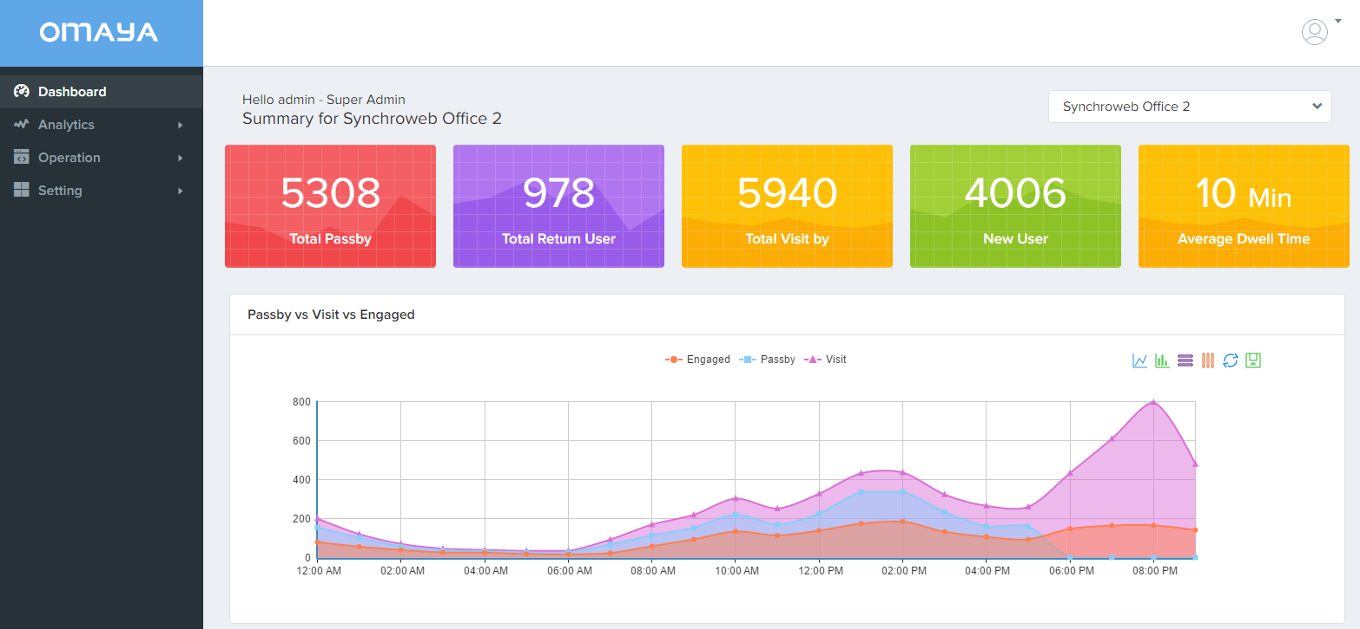
View of VM View of Manager

Slide 14
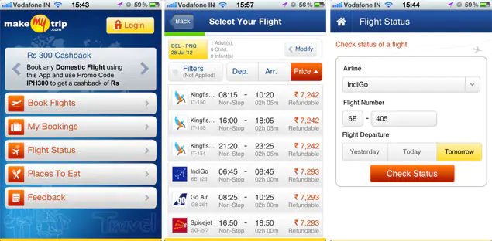
-Date wise Sales -Datewise Attendance
-Date wise image upload -Date wise Inventory Stock

Slide 15
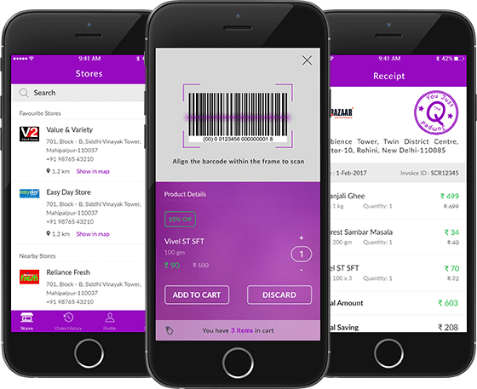
-Inventory List
-Stock as of today

Slide 16
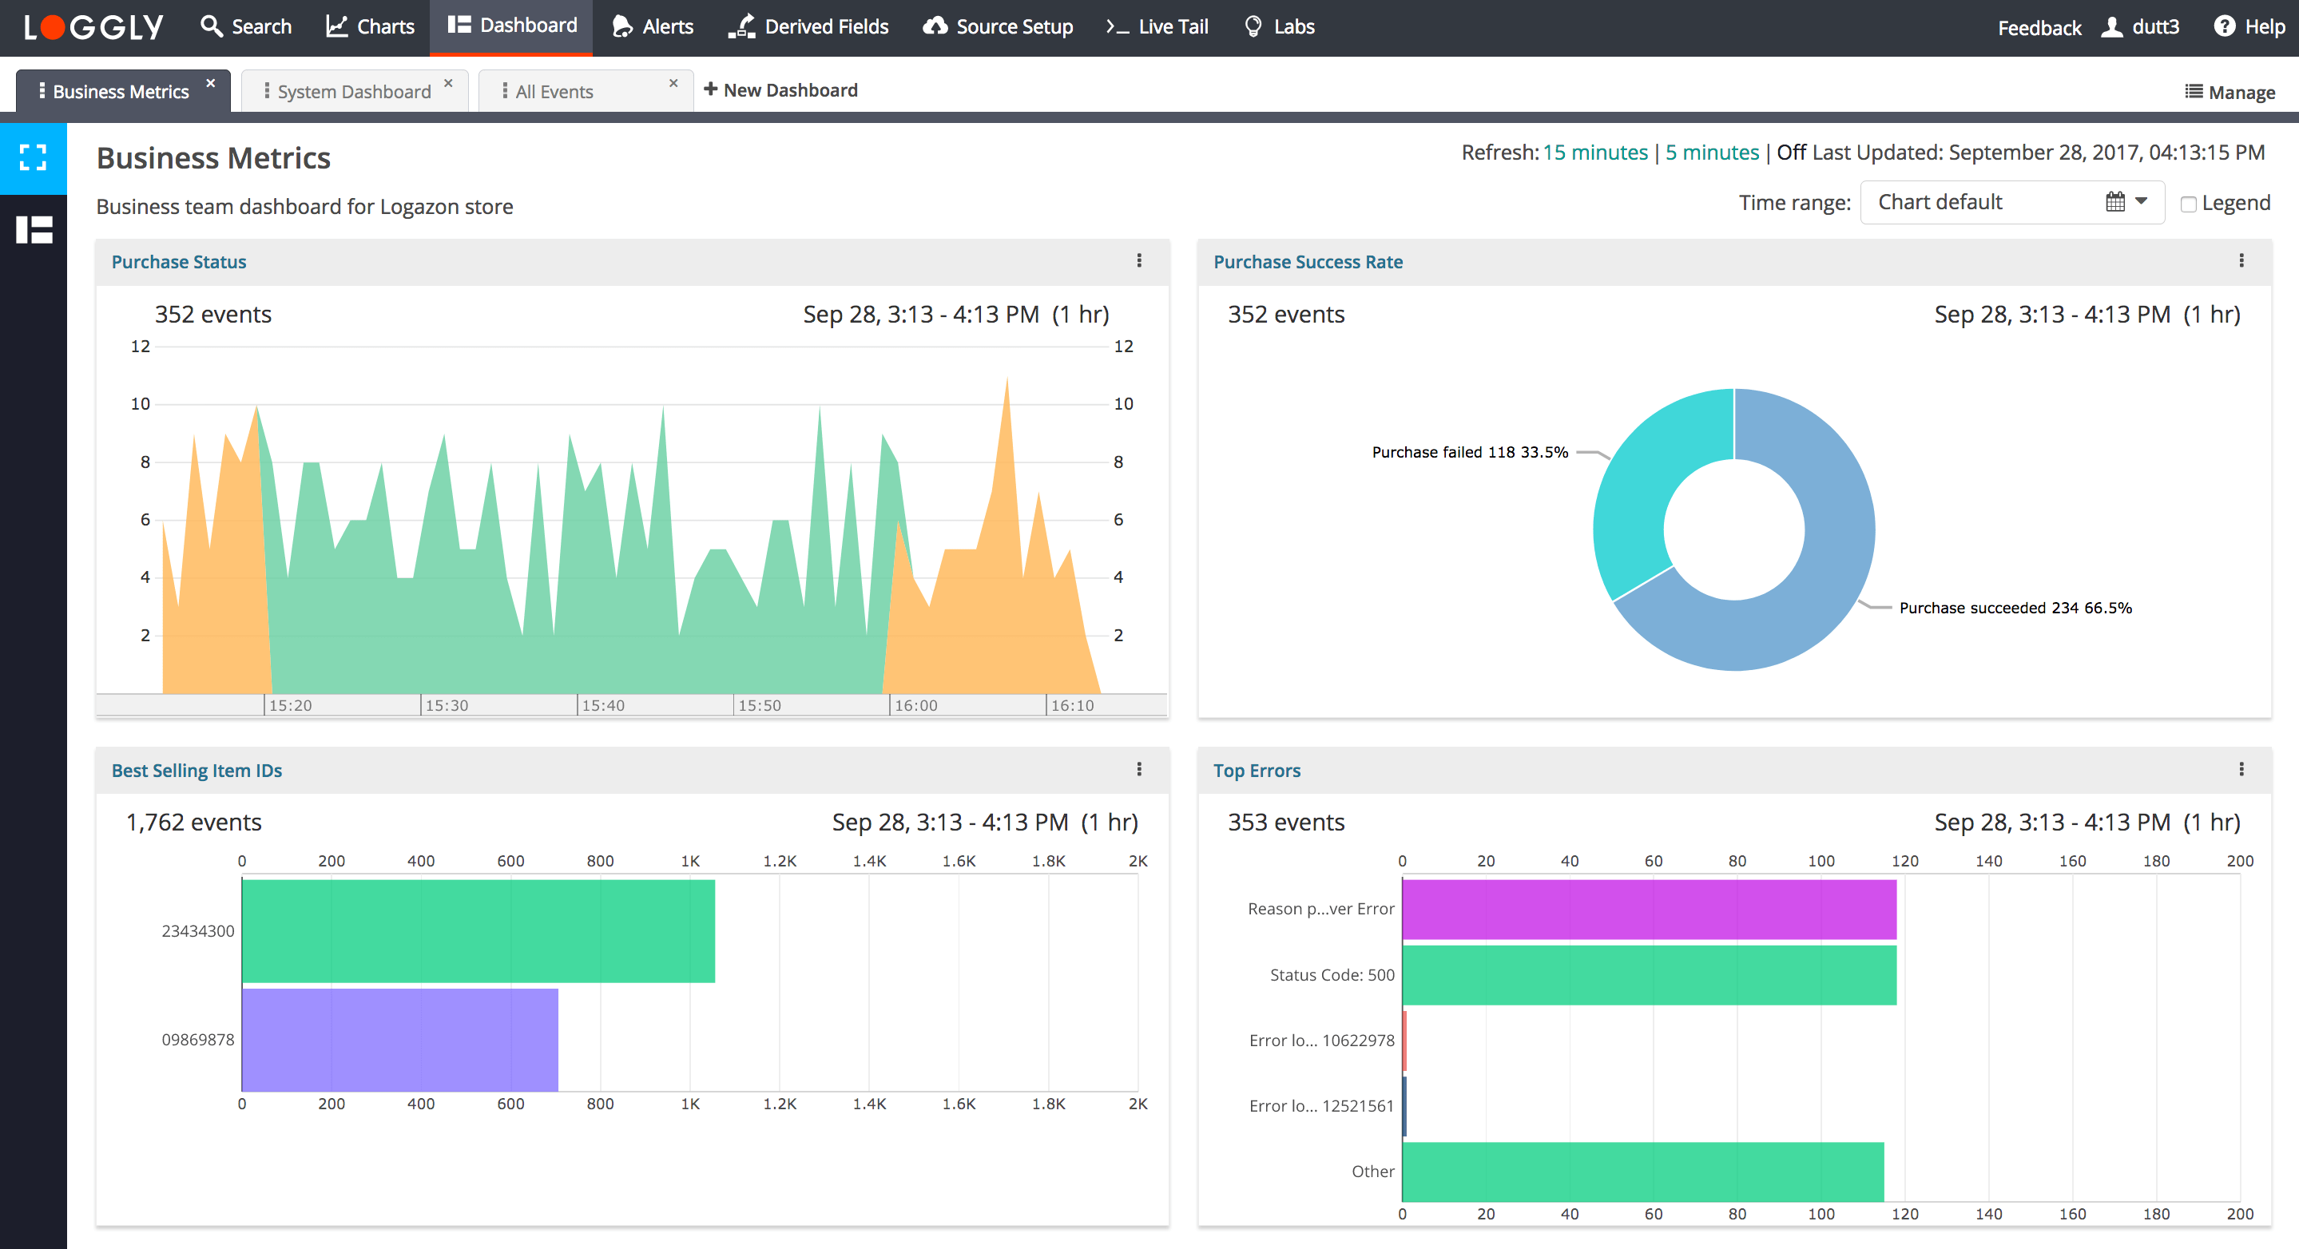
-Sales Trend Chart -Inventory List
-Attendance Graph -Weekly Events & New Update

Slide 17
Mobile App Design Plan

Slide 18

Front Screen (Validation on ID and Password)
3 types of access : VM/Manager/ For all
VM Access : To upload Attendance
VM Access : To upload Sales Weekly
VM Access : To upload Fortnight PPT
VM Access : To upload Daily Store View
VM Access : To upload VM Material details
Email Id
Manager Access : To view Attendance
Manager Access : To review Sales Weekly/Monthly PPT
Manager Access : To review Daily Store View
Manager Access : To review VM Material Details
Manager Access : To send comments to uploads
Password
Forgot Password?
SIGN IN
Others Access : To view Sales Trend Chart.
Others Access : Monthly PPT / Uploads
Login with gmail
SIGN UP

Slide 19
VM View

Slide 20

Profile Image
Attendance
Upload Today’s View
Fortnight PPT
Sales Report
**************
**************
VM Materials
Check Comments
**************
**************
Update Schedule
Profile
Settings
Attendance Tab is not required for the EBO.

Slide 21
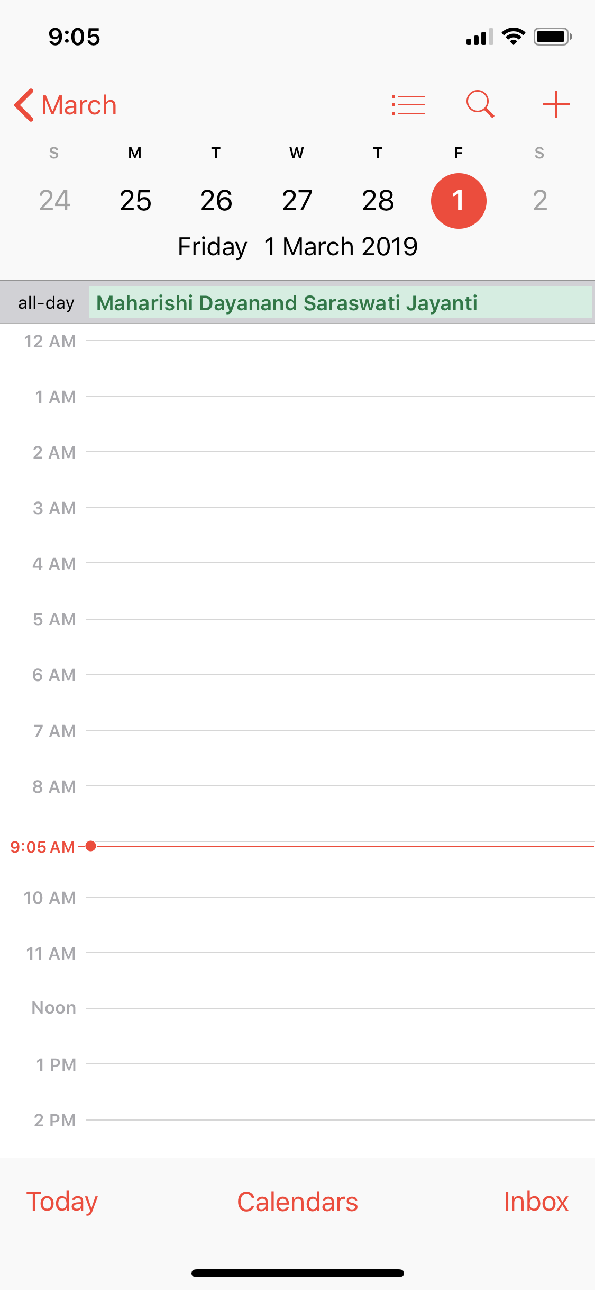
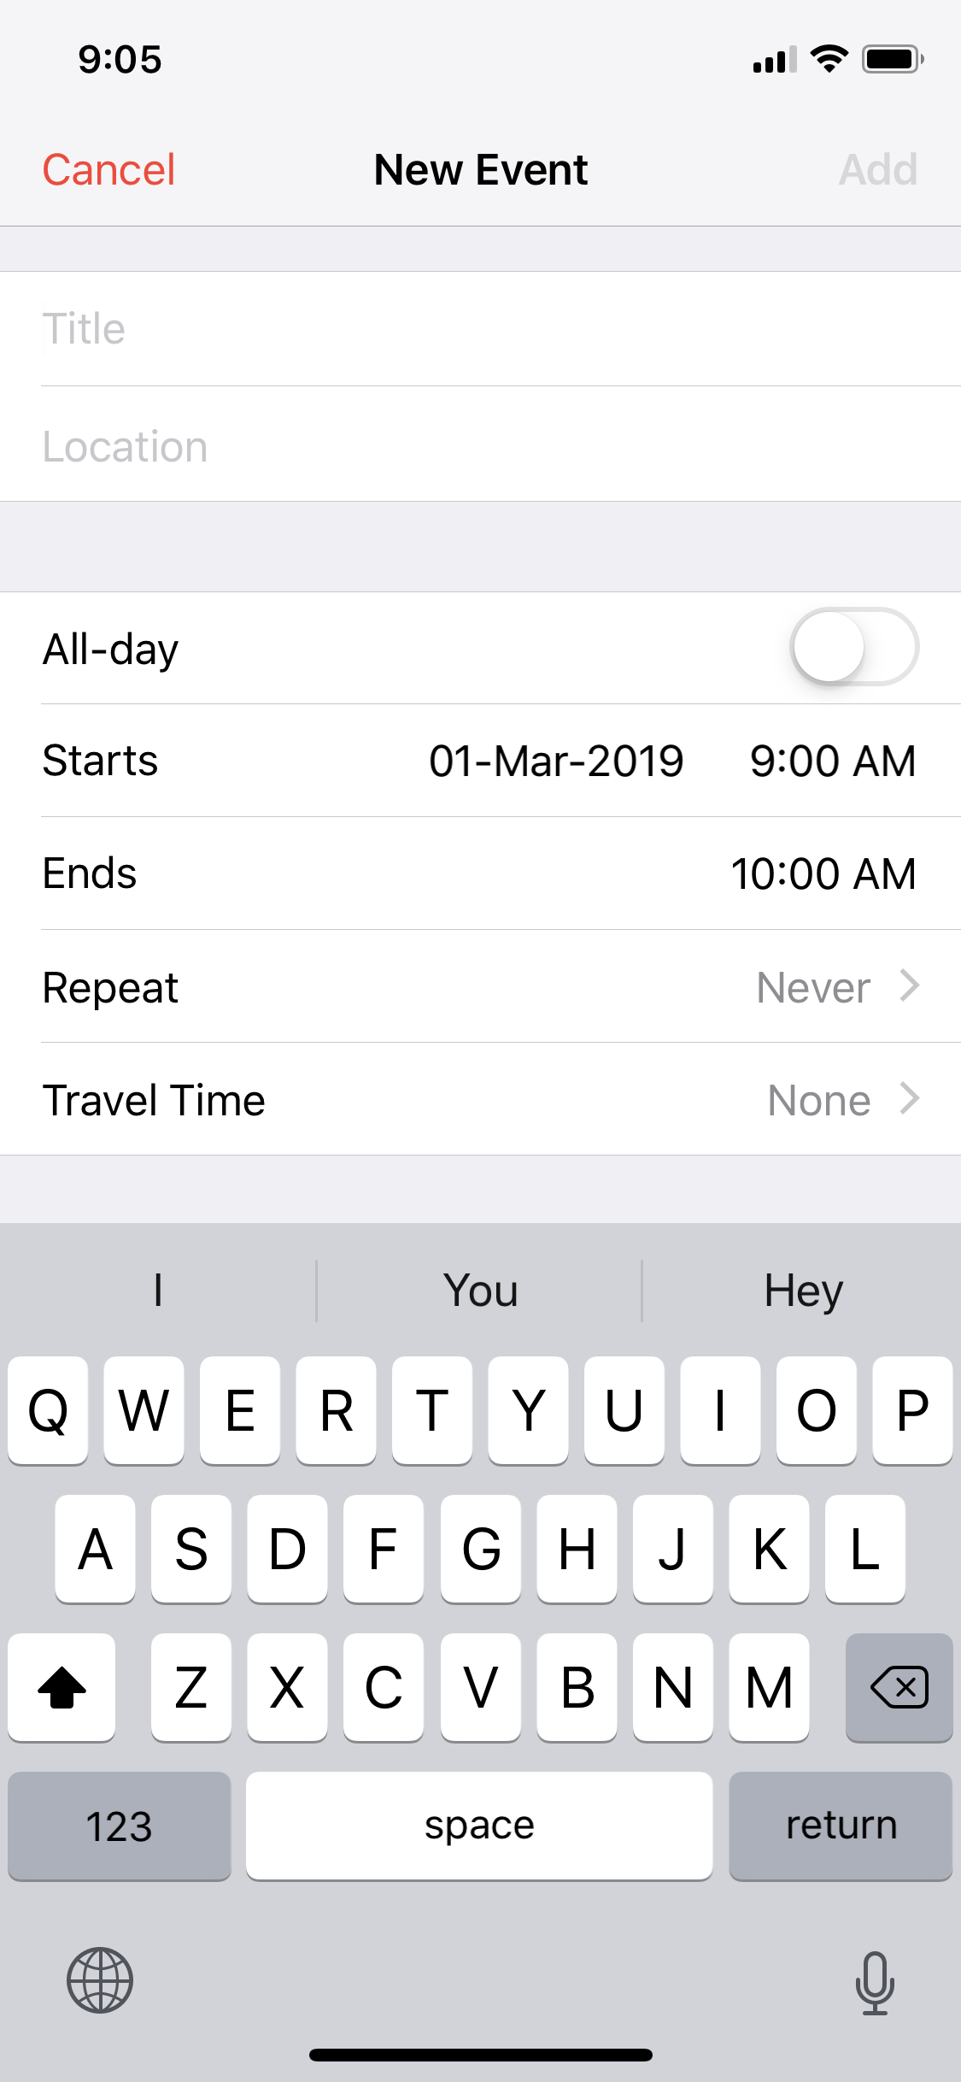

Schedule Update
<March >
Holiday
Present
Absent

Slide 22
Select Region
Attendance
Upload Today’s View
Select Store Name
Select Brand
Fortnight PPT
Sales Report
VM Materials
Check Comments
Submit
Profile
Settings

Slide 23
Attendance
Upload Today’s View
Punch in
Punch out
<March >
Fortnight PPT
Sales Report
VM Materials
Check Comments
Attendance Details
Date: 30/3/2019
Hours: 8 hours
In Time: 10:00 a.m.
Out Time: 6:00 p.m.
Profile
Holiday
Settings
Present
Absent

Slide 24
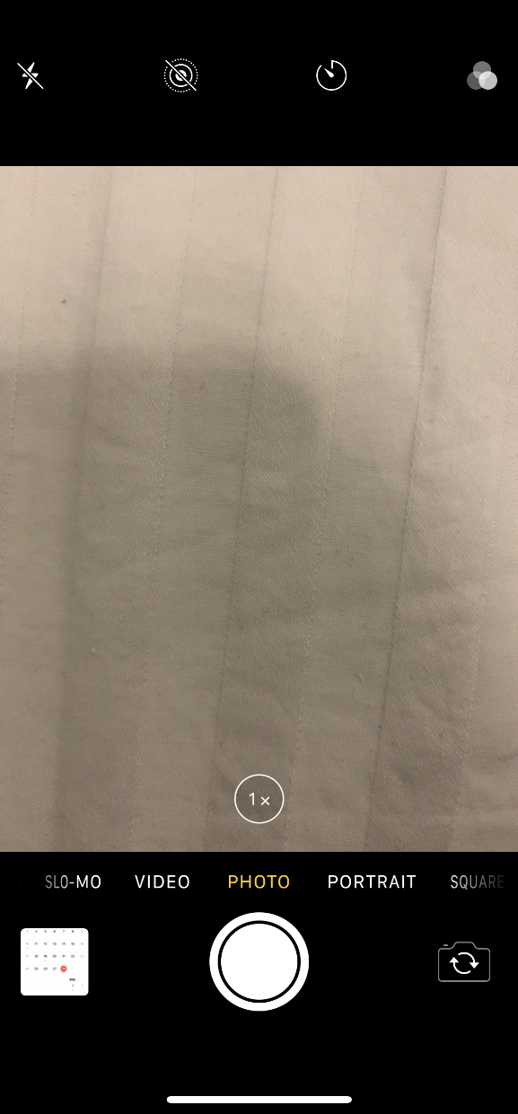
Attendance
Upload Today’s View
Fortnight PPT
Sales Report
VM Materials
Check Comments
Profile
Settings
Upload Today’s view is not required for EBO.

Slide 25
Attendance
Upload Today’s View
Upload
Fortnight PPT
Sales Report
VM Materials
Check Comments
Profile
Settings
For EBO , They have to upload the PPT every week.

Slide 26
Attendance
Upload Today’s View
Upload
Fortnight PPT
Sales Report
VM Materials
Check Comments
Profile
Settings

Slide 27
Attendance
Upload Today’s View
Hanger
Fortnight PPT
Sales Report
Prop
It has to be updated on daily basis
Visual
VM Materials
Check Comments
Marketing com
Profile
Settings
Sales Report has to be submitted on weekly basis.

Slide 28

Attendance
Upload Today’s View
Fortnight PPT
Sales Report
VM Materials
Check Comments
Profile
Settings

Slide 29
Managers View

Slide 30
Select Region
Attendance
8/8
Today’s
Upload
130/170
Select Store Name
Select Brand
PPT
8
Sales Report
156
Select Date
VM Materials
Comments
Submit
PPT tab will have two further tabs – 1) Fortnight PPT for others. 2) Weekly PPT for EBOs

Slide 31
Others View

Slide 32
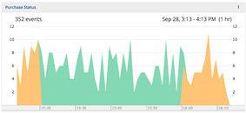
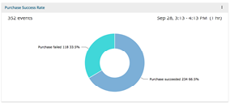
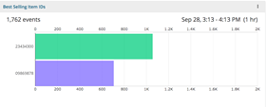
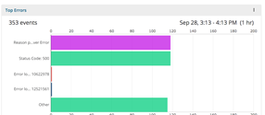
Today’s
Upload
130/170
PPT
8
Sales Report
156

Slide 33
Advantages
Strong in-store Visuals
Reduced wait time (By days)
Increased Visibility
Regular display update
Better Customer Service

Slide 34
THANK YOU

